Slide 1

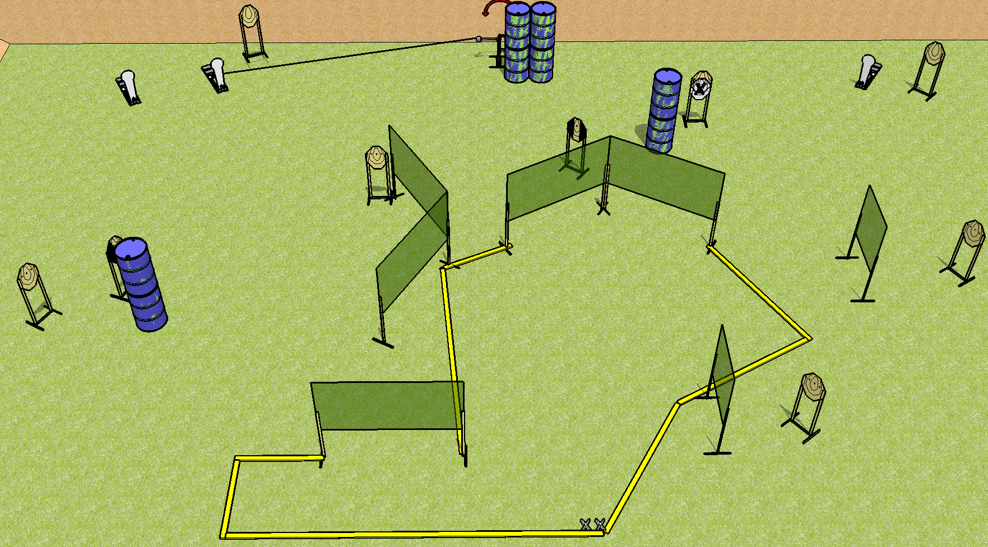
 | Dothan Practical Shooters – USPSA Match Reecycled Course Designer : Drew Coleman Bay: A2
Round Count 23 rounds 10 IPSC 3 Colt poppers
Equipment List 14 wall feet Swinger + activator 1 left diag + 1 tux 9 targets (8 + 1NS)

Slide 2
Reecycled
Written Stage Briefing
Scoring: Comstock Rounds: 23
Targets: 10 IPSC, 3 steel
Handgun start position: Heels on X’s, wrists below belt. Handgun is holstered with loaded mag, empty chamber.
PCC start position: Heels on X’s, stock on belt. Carbine has magazine inserted, empty chamber, held with both hands.
Stage Procedure: on the audible start signal, engage targets as they become available from within the shooting area. The swinger is activated by P2 and remains visible at rest.

